Slide 1
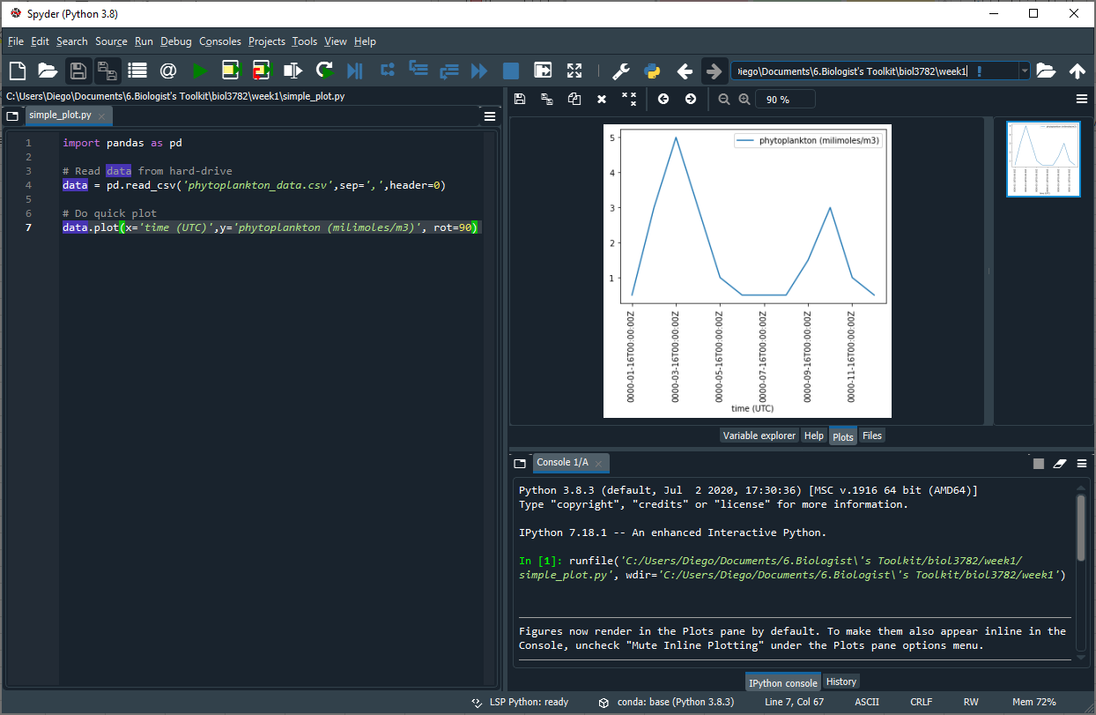

Slide 3
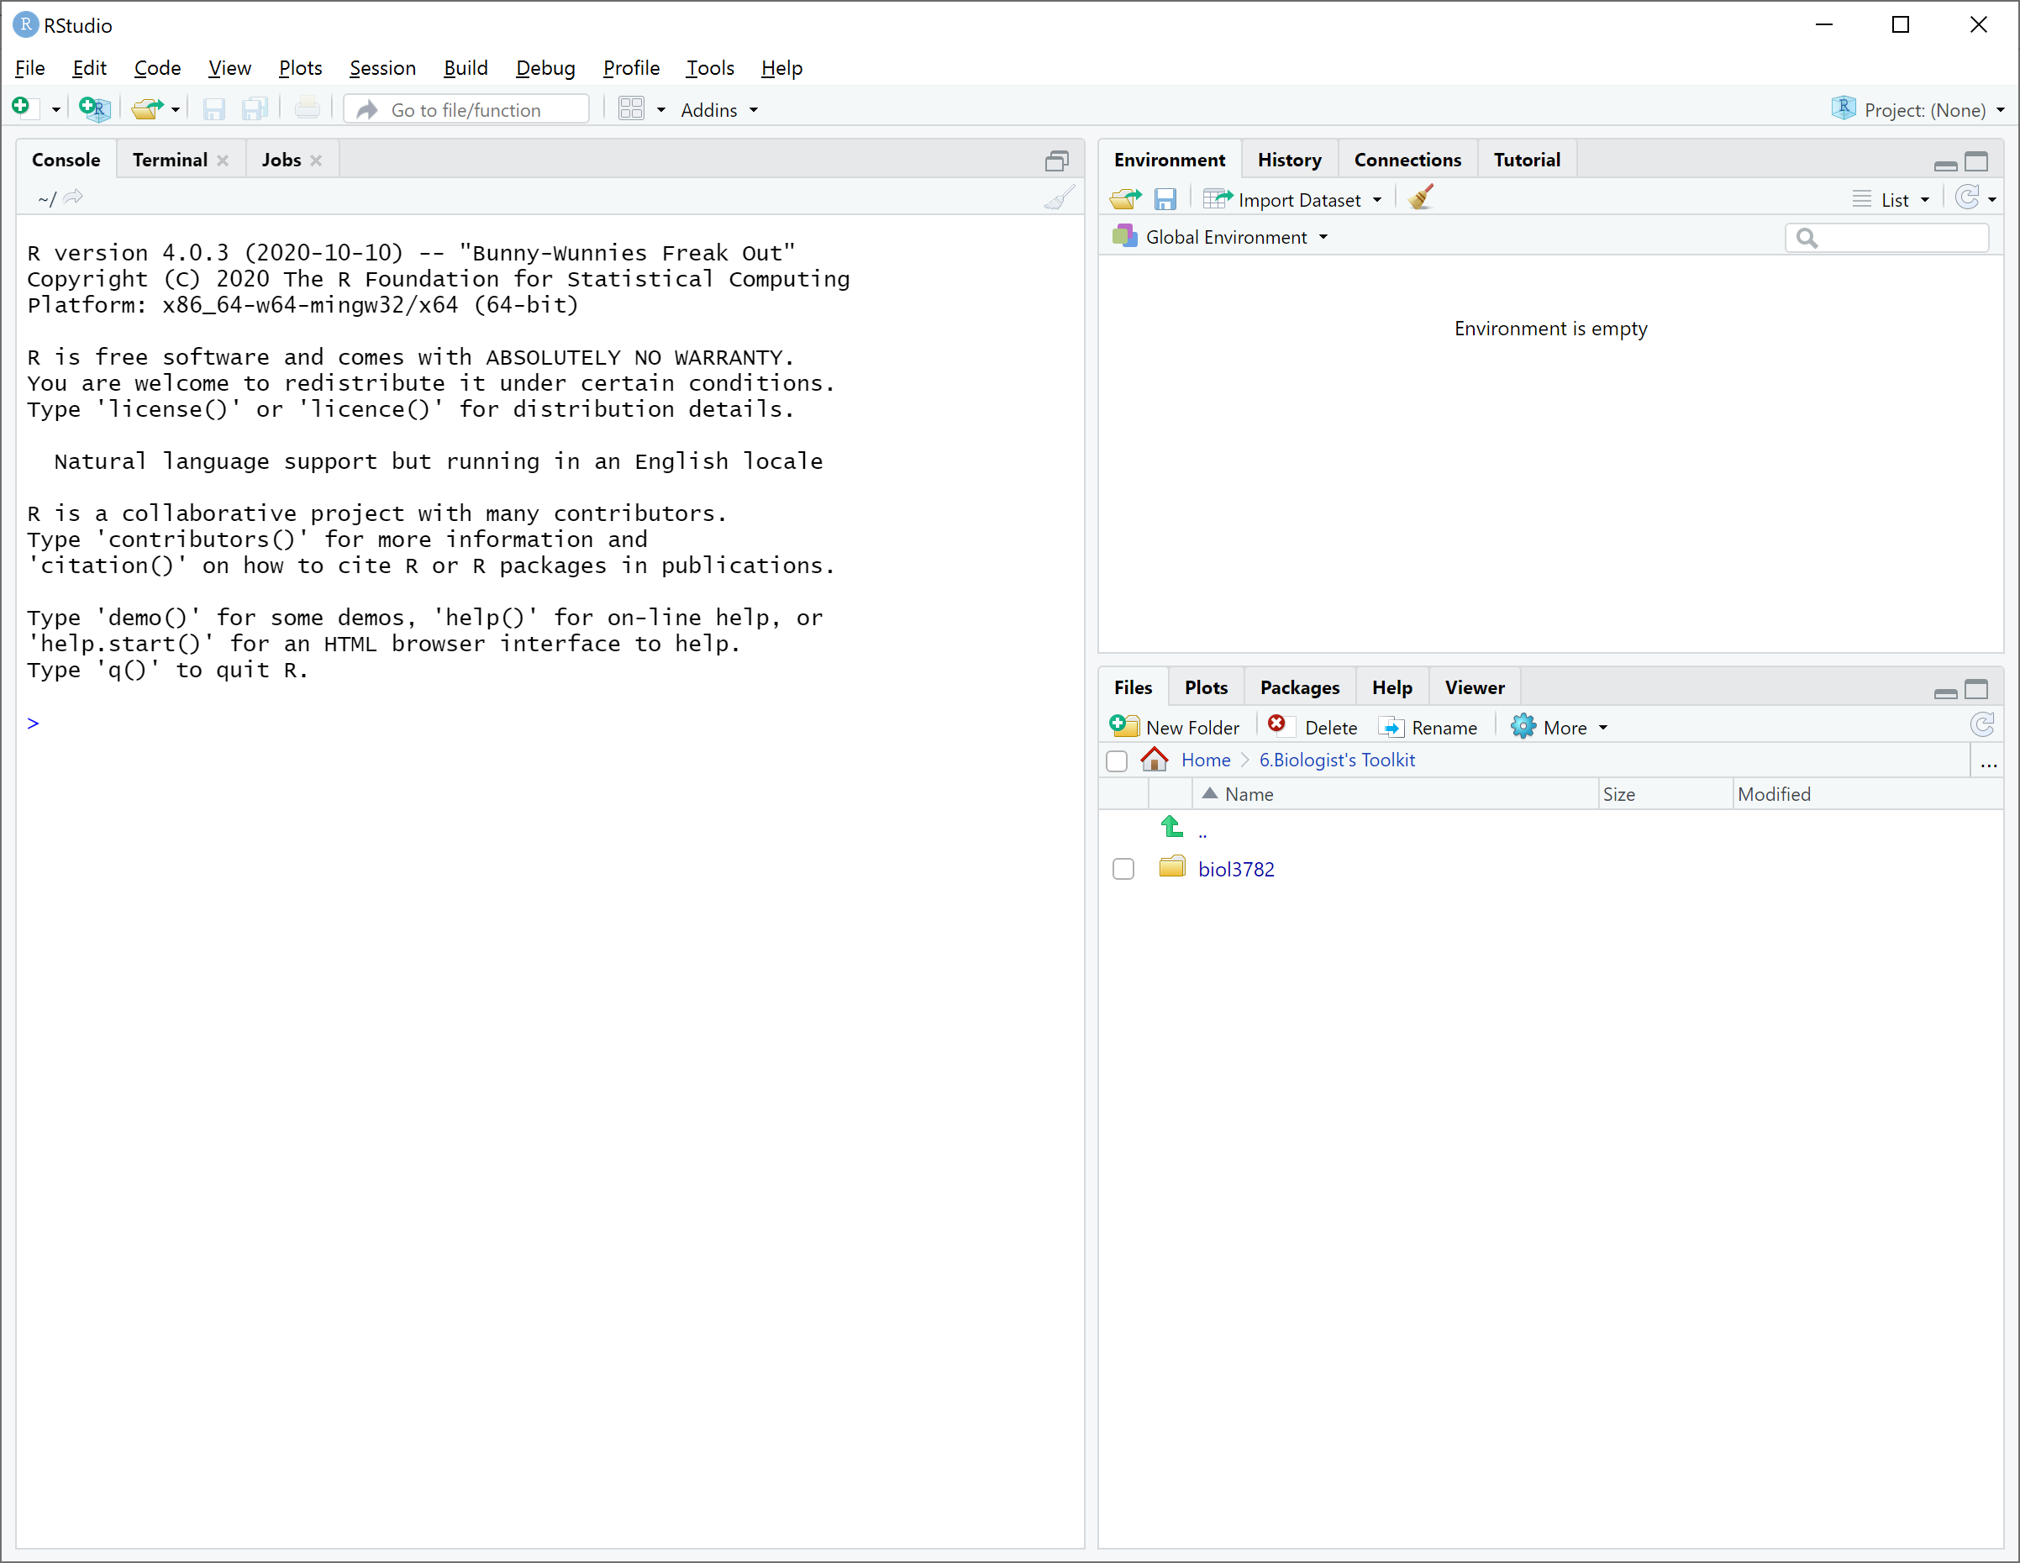

Slide 4
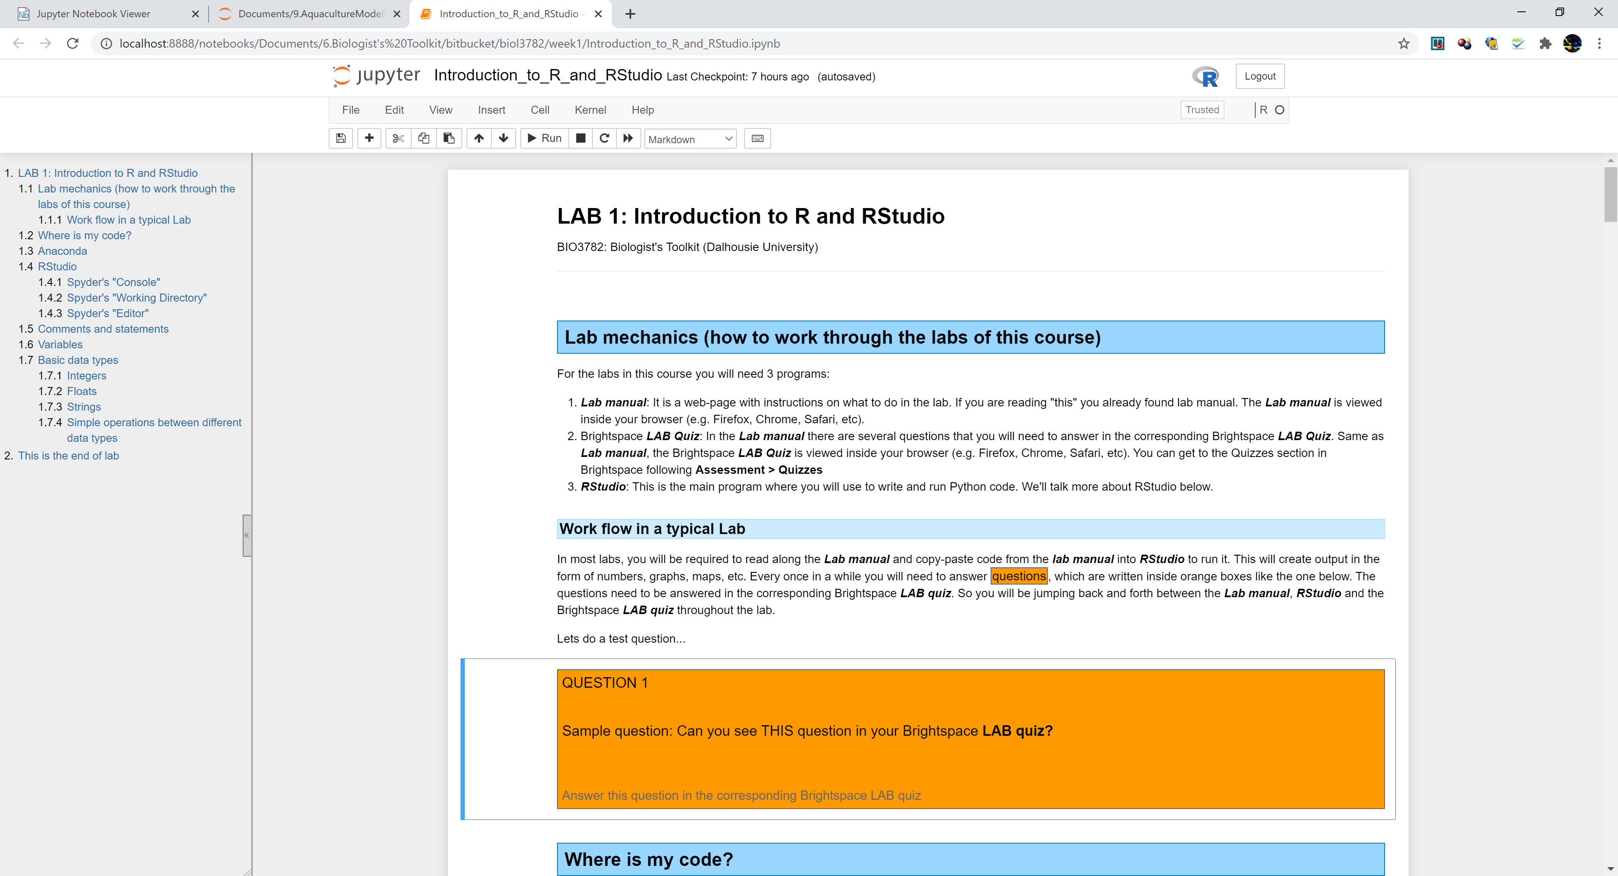
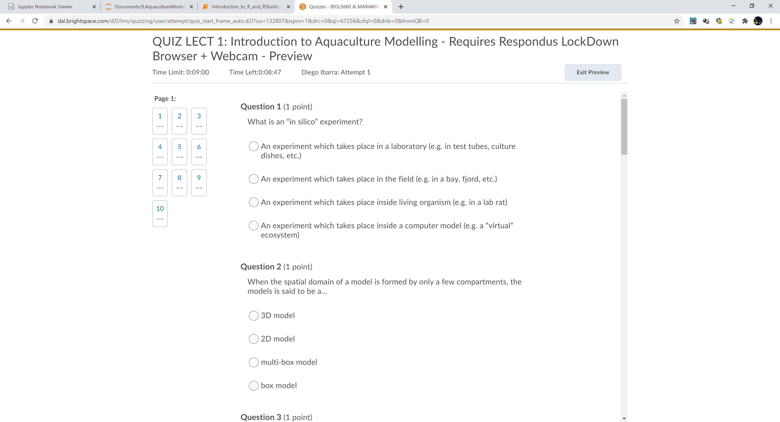
Lab manual
Brightspace Quiz
RStudio

Slide 5
CONSOLE

Slide 6
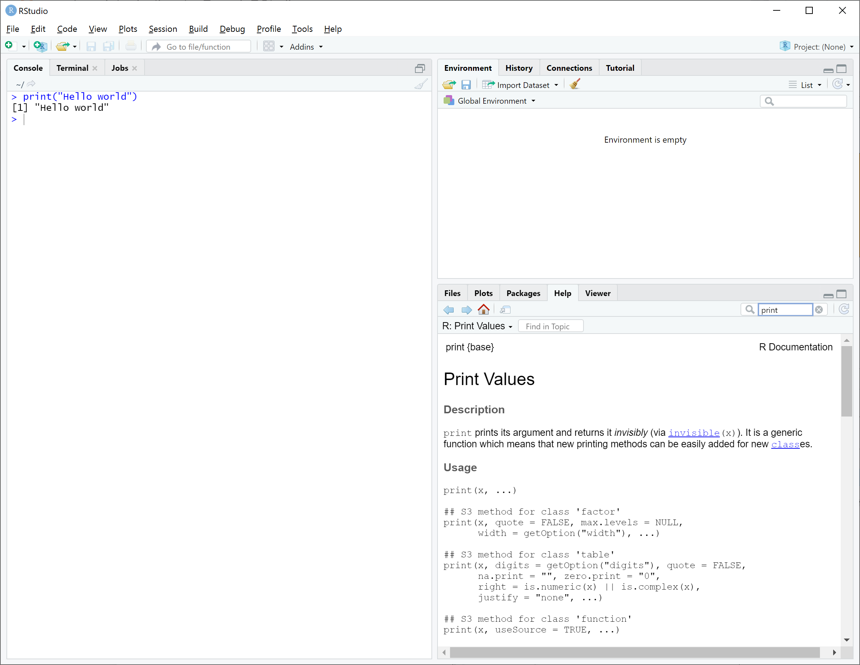
Tab
Search bar
Help panel

Slide 7
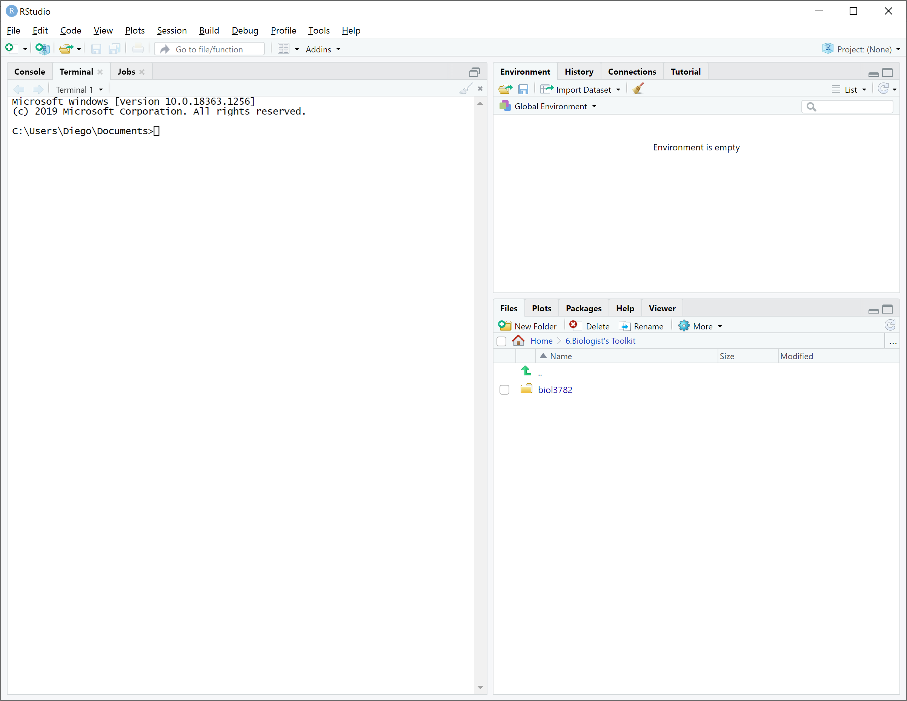

Slide 8
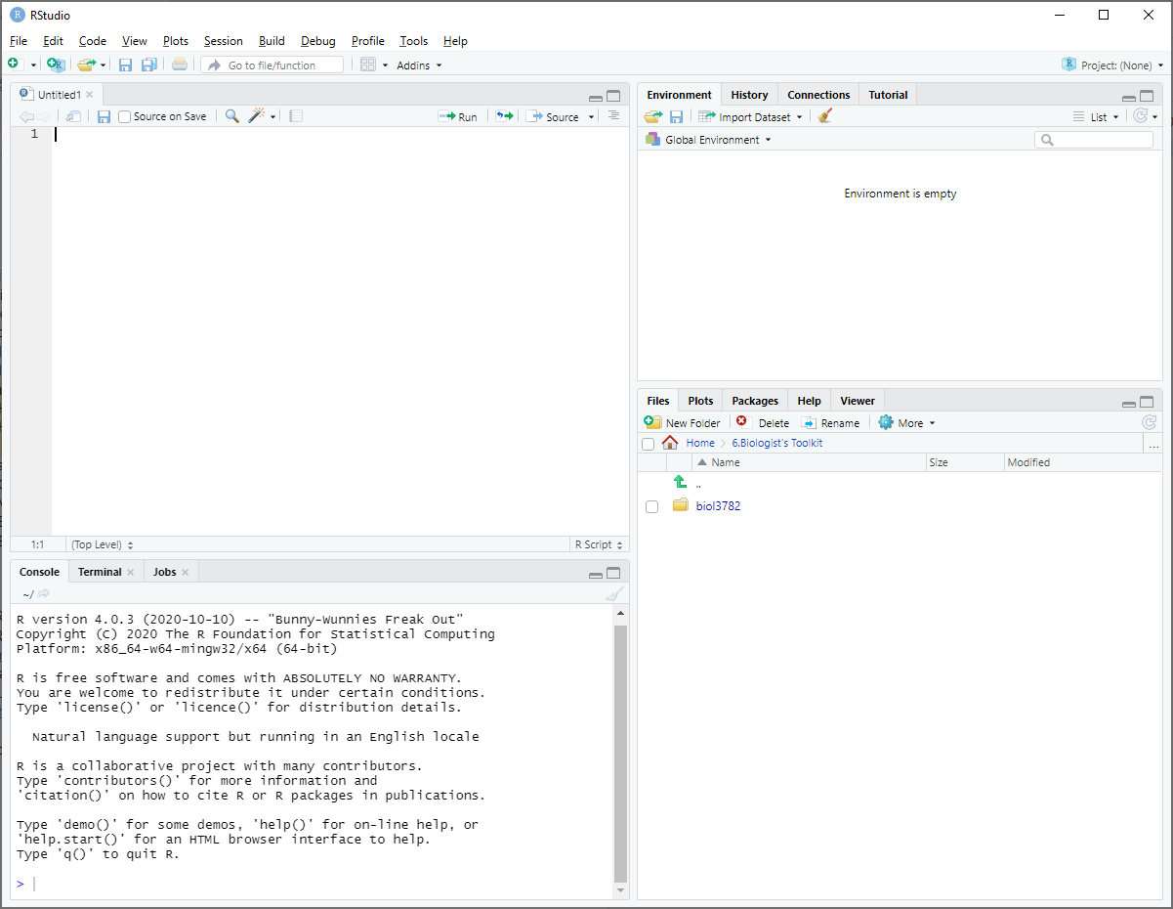

Slide 9
Editor

Slide 10
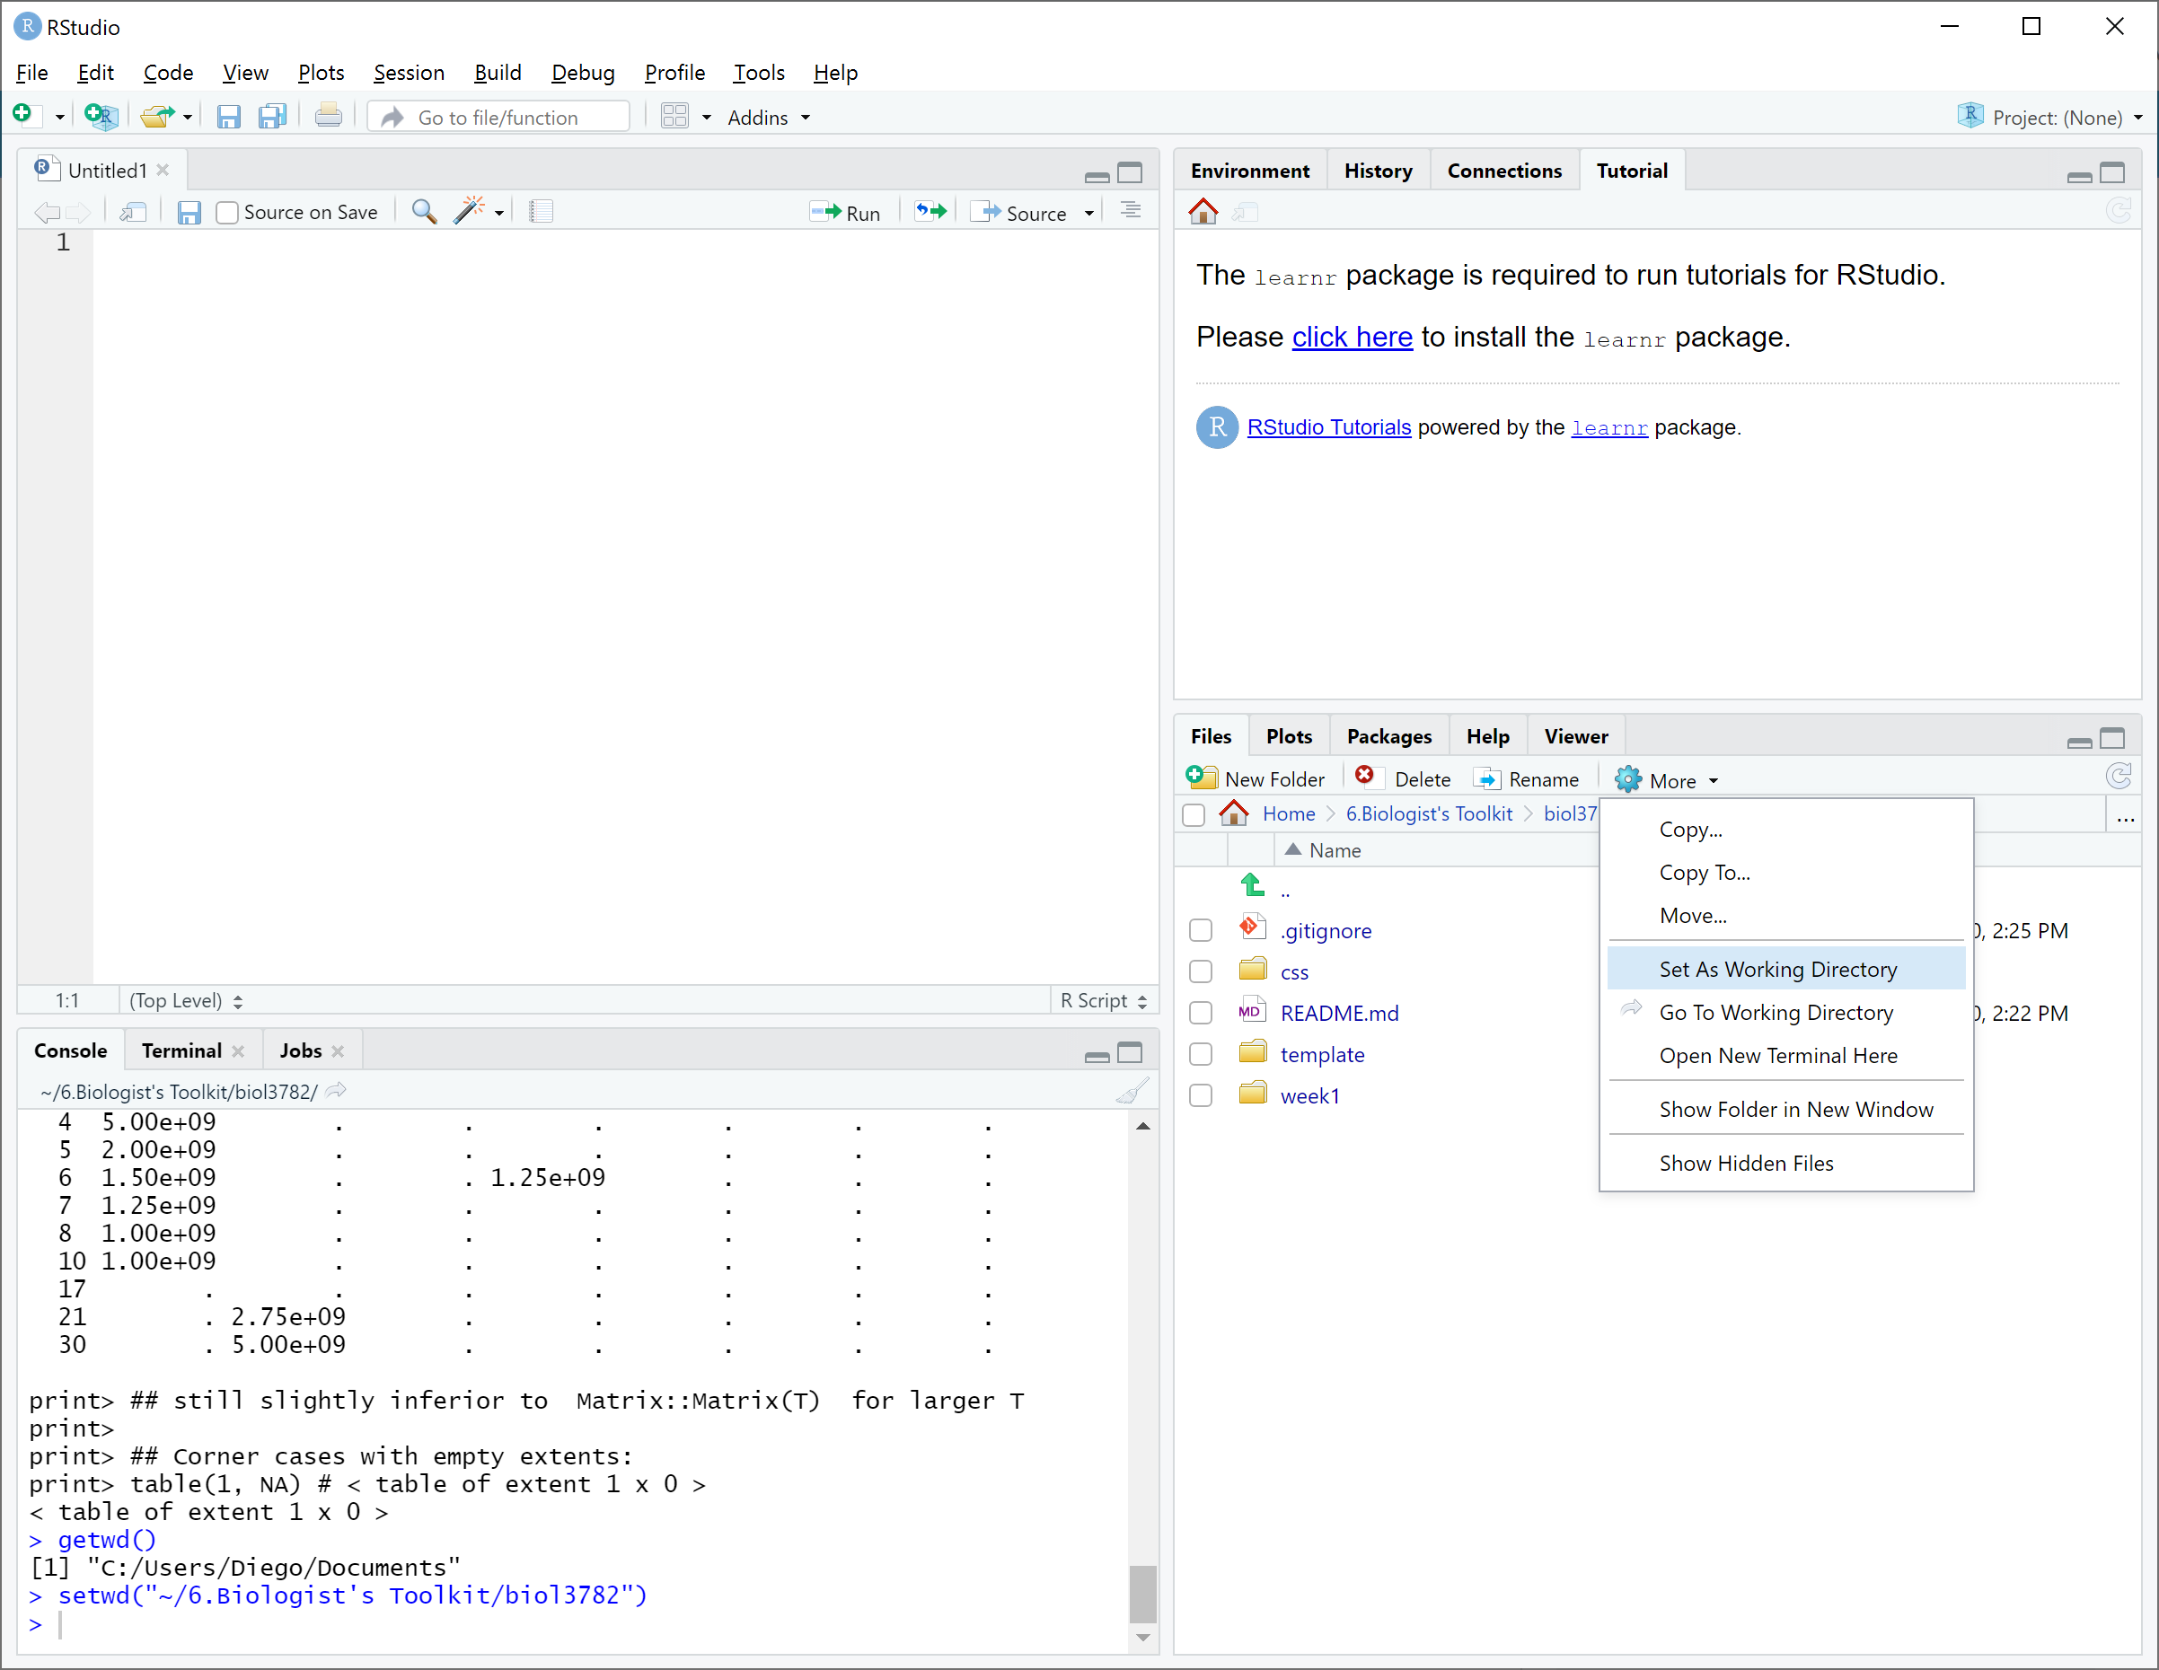

Slide 11
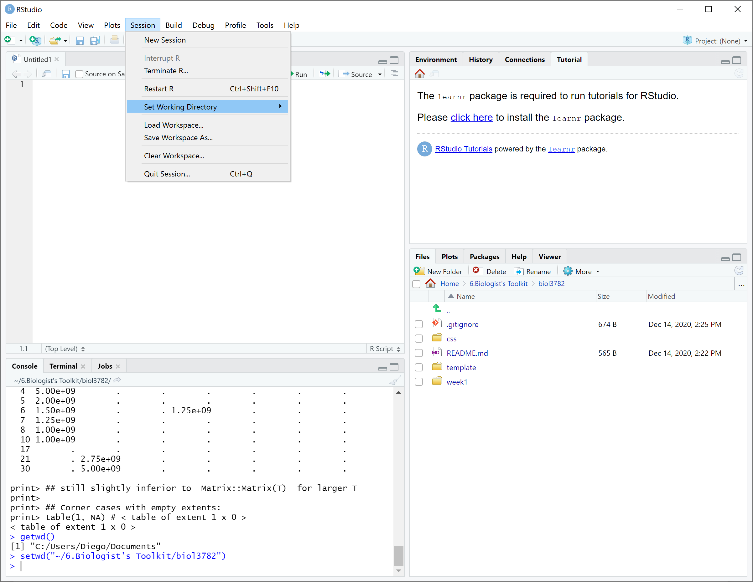

Slide 12
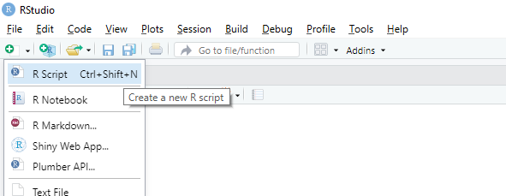

Slide 13
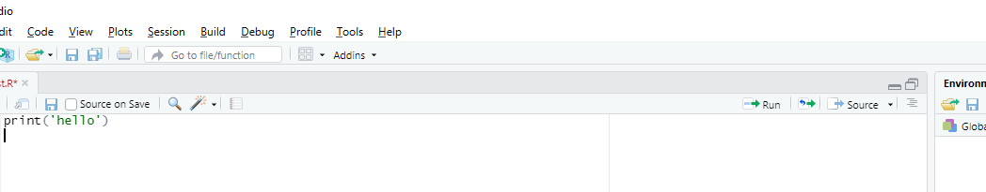
Buttons to run code

Slide 14
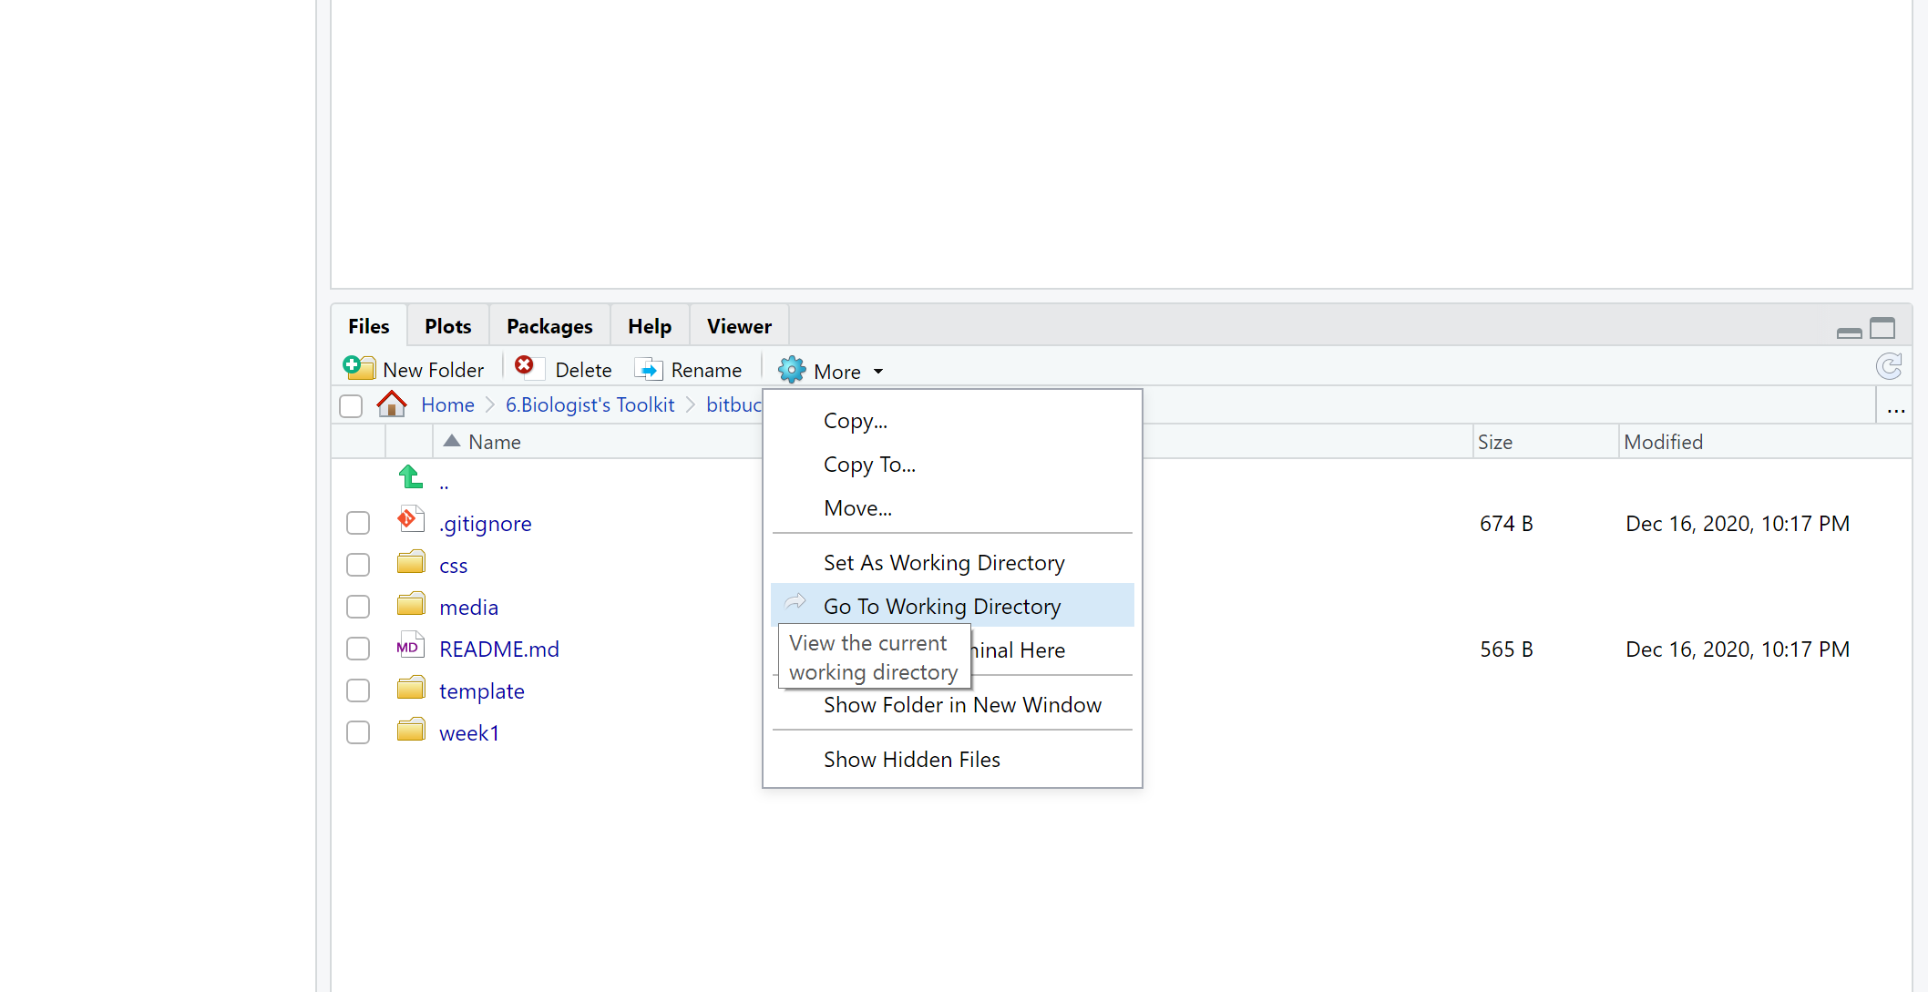

Slide 15
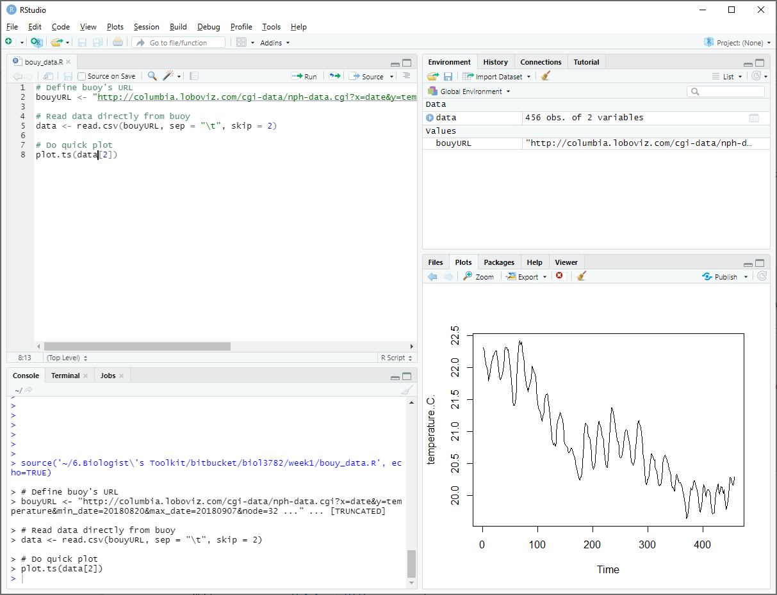
Plots panel

Slide 16
Environment panel

Slide 17
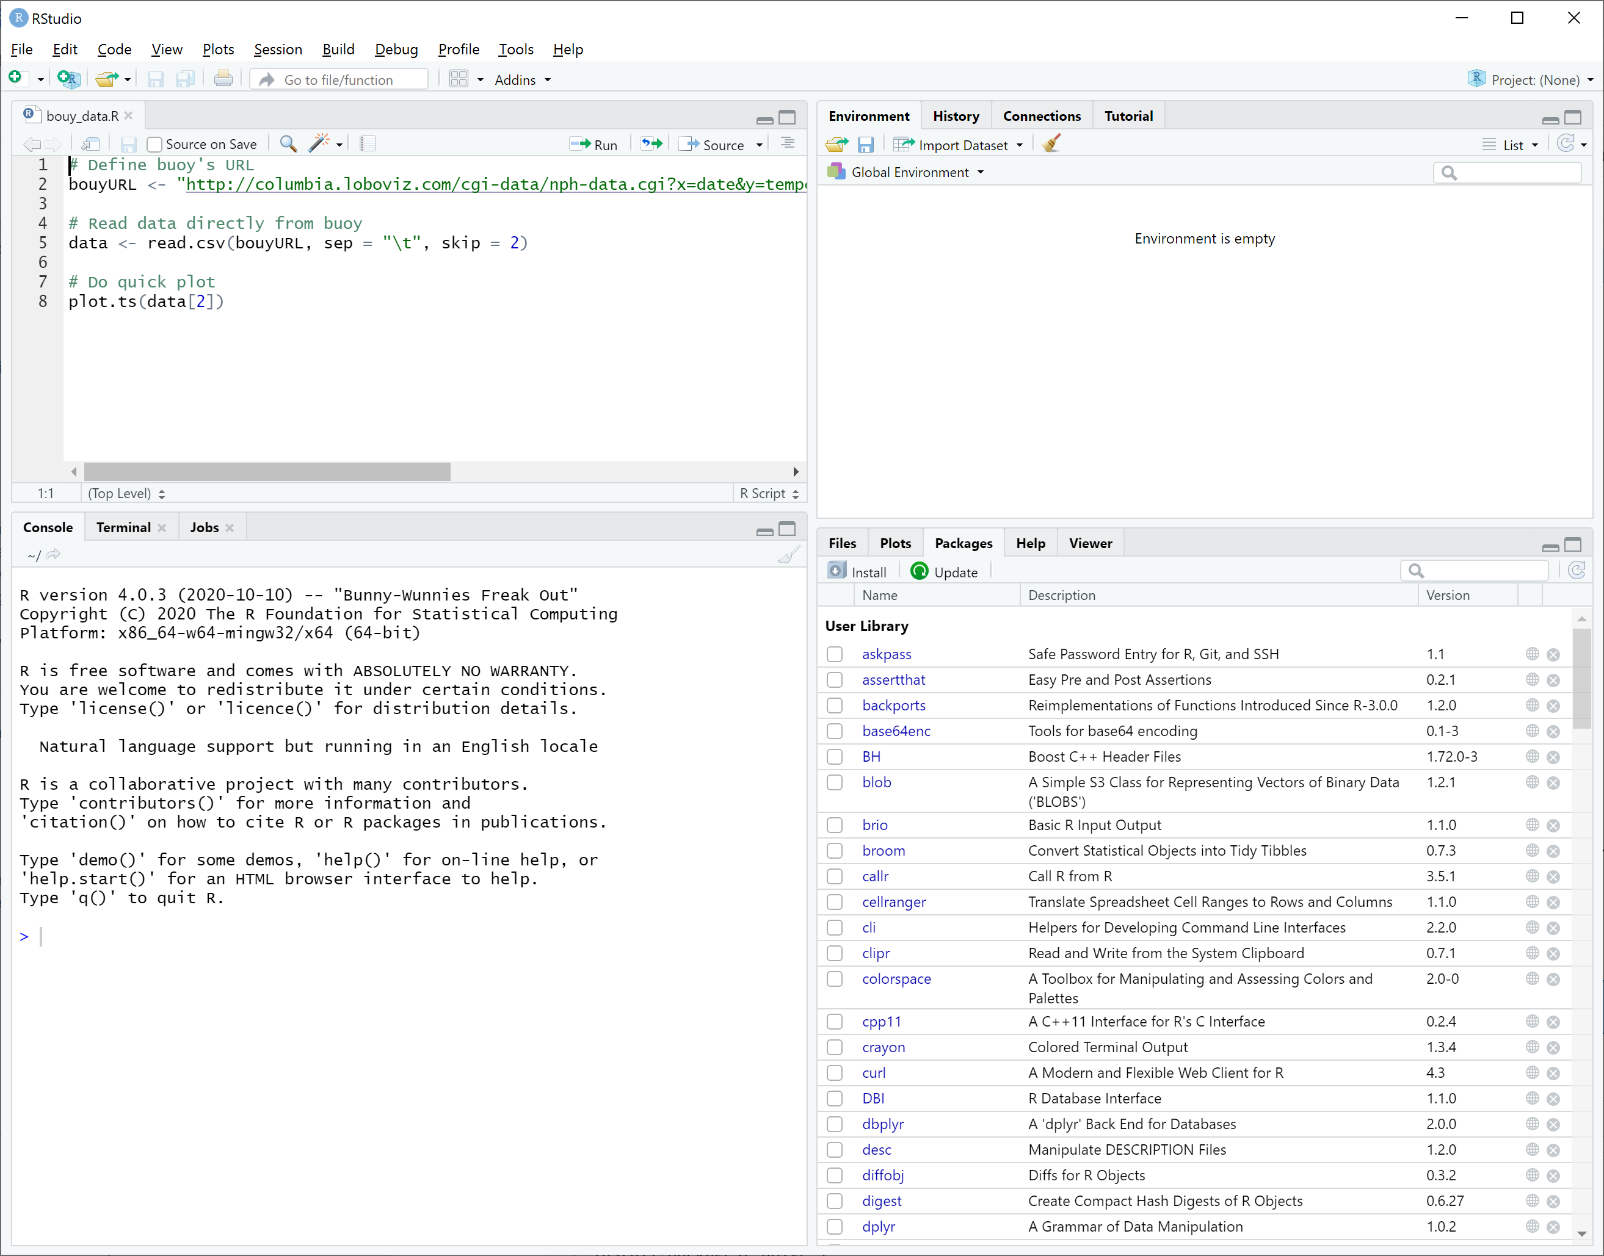
Packages panel

Slide 18


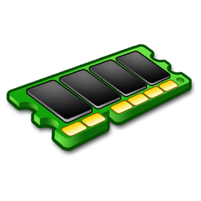

Your computer
The Cloud
Screen
Harddrive
Memory

Slide 19

The Cloud
Memory
2) load
The R
Directory
Harddrive
1) Install

Slide 20
Function
Input
Output

Slide 22
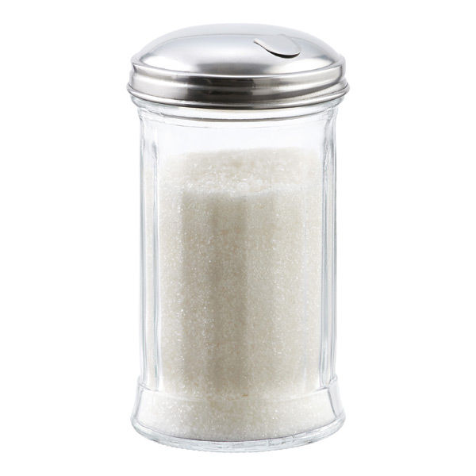

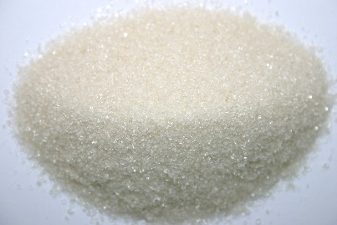
Sugar

Slide 23
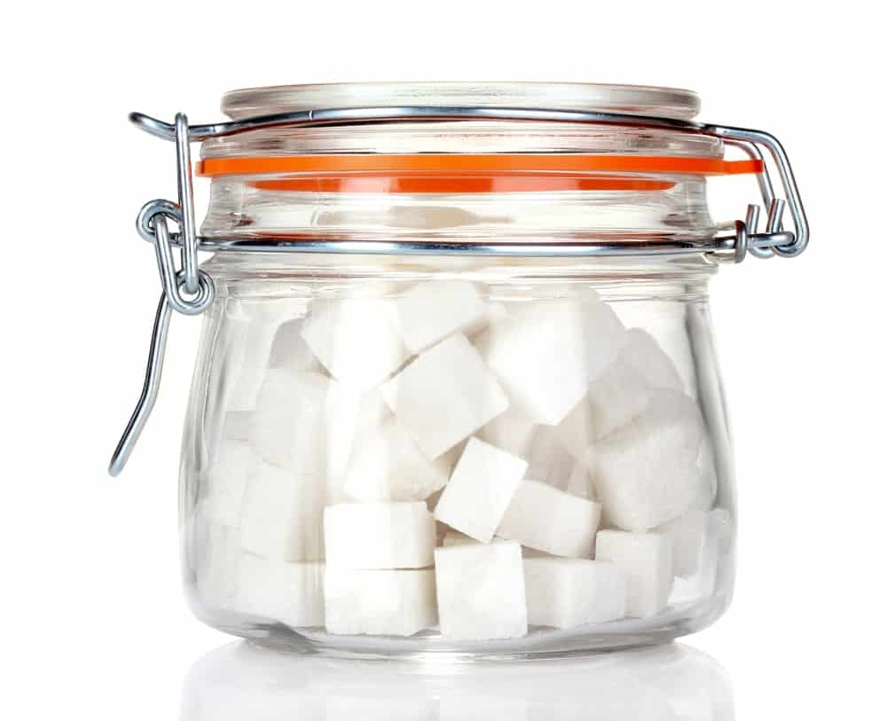
Sugar

Slide 24
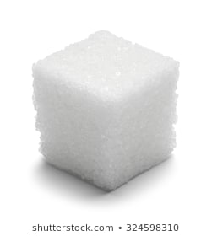
Sugar

Slide 25
8
5
3
1
9
2

Slide 26
7L
“hello”
3.6
7
5
2
9
“world”

Slide 27
2
5
0
4
3
6
7
9
8
3
7
2

Slide 28
x
y
z
2
3
4
3
4
5
4
5
6
5
6
7
6
7
8

Slide 30
5
5
2
2
7
7
4
4

Slide 32
6
6
“hello”
“hello”
FALSE
FALSE
5
2
7
4
5
2
7
4
3.67
3.67
“world”
“world”
8L
8L

Slide 33
6
6
“hello”
“hello”
FALSE
FALSE
5
2
7
4
5
2
7
4
3.67
3.67
“world”
“world”
8L
8L

